Slide 1
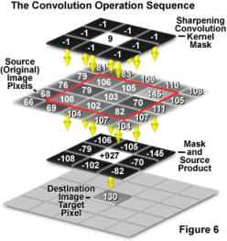
Basic Image Operation (IV) 图像基本操作(IV)
Mingli Song
College of Computer Science, Zhejiang University
brooksong@zju.edu.cn
http://person.zju.edu.cn/msong/

Slide 2
1D convolution
1．Continuous 1D convolution
2．Properties of convolution
3．Discrete 1D convolution
4. Spatial domain filtering

Slide 3
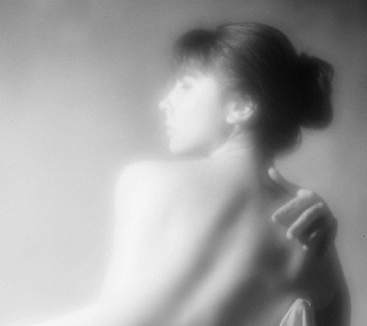
Spatial filtering
Spatial filtering--smoothing
Smoothing can reduce noises and blurring, which can be used in preprocessing. For instance, remove the subtle details when you just want to extract the big target.
Image after low-pass filtering
Notes:
平滑空间滤波器用于模糊处理和减少噪声。模糊处理经常用于预处理，例如，在提取大的目标之前去除图像中一些琐碎的细节，桥接直线或曲线的缝隙。

Slide 4
Spatial filtering
Spatial filtering--smoothing
Linear smoothing filter
Statistical sorting filter
Image after low-pass filtering

Slide 5
Spatial filtering
Linear smoothing filter——Concept
1
1
1
The output of the linear smoothing filter is the mean value of the pixels in the mask. It’s also called mean filter.
1
1
1
1
1
1
Notes:
平滑线性空间滤波器的输出是包含在滤波掩模邻域内像素的简单平均值。因此，这些滤波器也称为均值滤波器。

Slide 6
Spatial filtering
Linear smoothing filter——application
1
1
1
Mean filter is mainly used for subtle detail removal, namely, eliminating the unwanted region smaller than the mask.
1
1
1
1
1
1
Notes:
均值滤波器的主要应用是去除图像中的不相干细节，即那些与滤波掩模尺寸相比更小的像素区域。

Slide 7
Spatial filtering
Linear smoothing filter——example
1
1
1
Simple mean, pixels in the mask window contribute equally to the final result.
1
1
1
1
1
1
1
2
1
Weighted mean, pixels in the mask window contribute unequally to the final result.
2
4
2
1
2
1
Two 3×3 mean filter, each filter’s factor equals to the sum of all the coefficients in order to obtain the mean value.
Notes:
简单平均，表示窗口中每一个像素对响应的贡献是一样的
加权平均，表示窗口中的像素对相应的贡献有大小之分。
两个3×3平滑（均值）滤波器掩模，每个掩模前边的乘数等于它的系数值的和，以计算平均值

Slide 8
Spatial filtering
Linear smoothing filter——general equation
where the size of the filter is (2a+1) ×(2b+1), w is the filter, f is the input image, g is the output image.
Notes:
其中，滤波器大小为(2a+1) ×(2b+1)，w为滤波器，f为输入图像，g为输出图像。

Slide 9
Spatial filtering
Linear smoothing filter——Explanation
The size of the mask is very important for the final result. When the mask is small, the blurring effect is very subtle, and vice versa.
Notes:
滤波掩模的大小与图像的平滑效果有直接的关系。当掩模比较小时，可以观察到在整幅图像中有轻微的模糊，当掩模大小增加，模糊程度也随之增加。

Slide 10
Spatial filtering
Linear smoothing filter——application
In order to obtain a brief description of the object of interest, linear smoothing filter is used to blur the image to remove the smaller object while keeping the larger object.
Hence, the size of the mask depends on the object to be merged into the background.
Notes:
为了对感兴趣物体得到一个粗略的描述而模糊一幅图像，这样，那些较小物体的强度与背景混合在一起了，较大物体变得像“斑点”而易于检测。掩模的大小由那些即将融入背景中去的物件尺寸来决定。

Slide 11
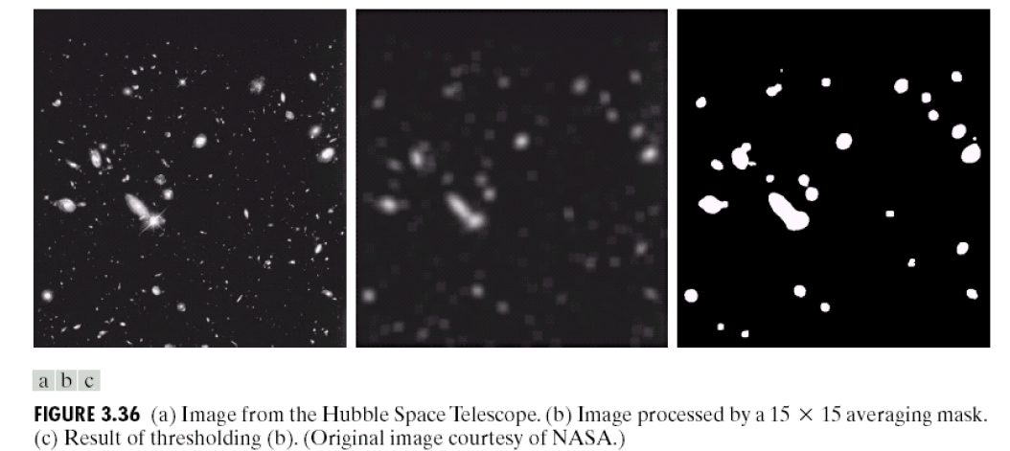
Spatial filtering
Linear smoothing filter——application

Slide 12
Spatial filtering
Statistical sorting filter——Concept
Statistical filter is a kind of nonlinear spatial filter, whose response is based on the sorting of pixel value in the mask window. The value of center pixel depends on the sorting result in the window.
The most popular statistical filter is median filter.
Notes:
统计滤波器是一种非线性的空间滤波器，它的响应是基于窗口内图像区域中像素值的排序，由统计排序结果决定的值代替中心像素的值。
统计滤波器中最常见的例子就是中值滤波器。

Slide 13
Spatial filtering
Statistical sorting filter——Median filter
Substitute the center pixel with the median value in the neighborhood.
Provide excellent de-noise ability, which introduce less blurring than the mean filter.
Be effective to deal with the pulse noise (or pepper noise) because this kind of noise looks like bright or dark point in the image.
Notes:
用像素邻域内灰度的中值代替该像素的值。
提供了优秀的去噪能力，比小尺寸的线性平滑滤波器的模糊程度明显要低。
对处理脉冲噪声（也称为椒盐噪声）非常有效，因为这种噪声是以黑白点叠加在图像上的。

Slide 14
Spatial filtering
Statistical sorting filter——median filter
The median value ξ——in a set of numbers, About half of them are smaller than ξ，others larger than ξ.
In order to perform median filtering on a pixel in the image, pixel sorting should be carried out in the mask window to select the median value and change the pixel value to the median value.
Notes:
中值ξ——数值集合中，有一半数值小于或等于ξ，还有一半大于或等于ξ。
为了对一幅图像上的某个点作中值滤波处理。必须先将掩模内欲求的像素及其邻域的像素值排序，确定出中值，并将中值赋予该像素点。

Slide 15
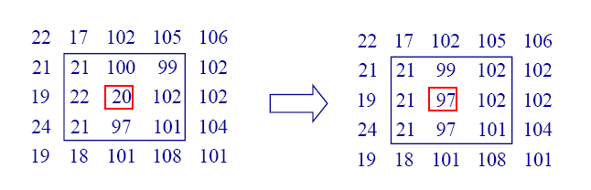
Spatial filtering
Statistical sorting filter——media filter, example
In a 3×3 neighborhood, there are a series pixel values：
（21，100，99，22，20，102，97，101）
After sorting：
（20，21，22，97，100，101，012）
Median value：97
Notes:
在一个3×3的邻域内有一系列像素值：
（21，100，99，22，20，102，97，101）
对这些值排序后为：
（20，21，22，97，100，101，012）
中值：97

Slide 16
Spatial filtering
Statistical sorting filter——median filter
Usually we use n×n median filter to remove the unwanted brighter or darker pixels in the neighborhood, and their area is less than n²/2（half of the mask window）.
Notes:
常用n×n的中值滤波器去除那些相对于其邻域像素更亮或更暗，并且其区域小于n²/2（滤波器区域的一半）的孤立像素集。

Slide 17
Spatial filtering
Sharpening spatial filter——Purpose
Enhance the detail or sharpen the blurred part in the image
Notes:
突出图像中的细节或者增强被模糊了的细节。

Slide 18
Spatial filtering
Sharpening spatial filter——Tool
Differential operator is a sharpening tool, whose response depends on the variation between neighboring pixel values.
Differential Operator strengthens the edges and other obvious variations (including noise) in the image, and weakens the slight changes.
Notes:
微分算子是实现锐化的工具，其响应程度与图像在该点处的突变程度有关。微分算子增强了边缘和其他突变（如噪声）并削弱了灰度变化缓慢的区域。

Slide 19
Spatial filtering
Sharpening operator
Concept of differential operator
Second order differential based image enhancement——Laplacian operator
First order differential based image enhancement——gradient based method
Notes:
基于二阶微分的图像增强——拉普拉斯算子
基于一阶微分的图像增强——梯度法

Slide 20
Spatial filtering
Differential——
For a function f(x)，we use difference to represent the differential operator:
Similarly, the second order differential is：
Notes:
对于函数f(x)，用差值来表达一阶微分：

Slide 21
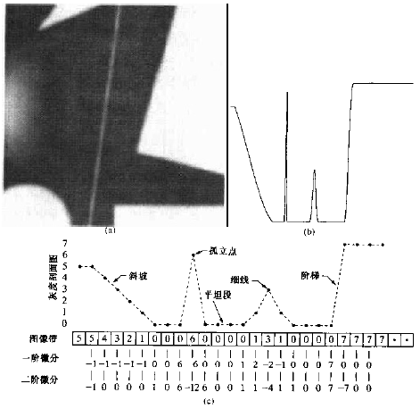
Spatial filtering
Differential——Example
A simple image, composed by solid object, line segment and single noisy pixel.
Profile of the image along with the central line, which includes a noisy pixel.
Simplified profile.by dot-line.
Notes:
(a) 一幅简单图像，包含各种实心物体、一条线及一个单一噪声点。 (b) 沿图像中心并且包含一个噪声点的一维水平灰度剖面图。(c) 简化的剖面图（用虚线连接点以简化描述）

Slide 22
Spatial filtering
Image enhancement based on first order differential operator——gradient based method
For a function f(x,y)，we first define a 2-D vector：
How to compute gradient?
Its magnitude is computed as:
Notes:
对于函数f(x,y)，首先定义一个二维列向量：

Slide 23
Spatial filtering
Image enhancement based on first order differential operator——gradient based operator
It’s time consuming to compute the gradients for all the pixels in the image. Hence, absolute value is usually used to replace the original gradient magnitude.
Notes:
当对整幅图像计算梯度时，运算量会很大，因此，在实际操作中，常用绝对值代替平方与平方根运算近似求梯度的模值：

Slide 24
Spatial filtering
Gradient based method——Another approach
z₁
z₂
z₃
-1
0
0
-1
z₄
z₅
z₆
0
1
1
0
z₇
z₈
z₉
Robert cross gradient operator, Gx=(z9-z5)
Gy=(z8-z6)
Original image, z_{i} is the pixel value, z₅ is the center pixel.
Or
Notes:
z_{i}为像素值，z₅为当前像素
Robert 交叉梯度算子，左上角对应当前像素。它们采用了如下交叉差分算法：Gx=(z9-z5)和Gy=(z8-z6)。梯度算法：

Slide 25
Spatial filtering
Image enhancement based on second order differential——Laplacian operator
For a function f(x,y), Laplacian operator is defined as:

Slide 26
Spatial filtering
The discrete Laplacian operator:
Along x axis:
Along y axis:
Hence, the discrete Laplacian operator is:
Notes:
在x方向上对二阶偏微分采用下列定义：

Slide 27
Spatial operator
Mask of Laplacian operator
0
1
0
1
-4
1
0
1
0
It is rotation invariant.
Notes:
各向同性，旋转不变。

Slide 28
Spatial filtering
Extending the mask
The elements in the diagonal direction can also be taken into account：
Or
Notes:
对角线上的元素也可以考虑进来设计掩膜

Slide 29
Spatial filtering
Extended mask
1
1
1
1
-8
1
1
1
1
It’s also rotation invariant, i.e., isotropic.

Slide 30
Spatial filtering
Extended mask
0
-1
0
-1
-1
-1
-1
4
-1
-1
8
-1
0
-1
0
-1
-1
-1
When you fuse the Laplacian result and the original image together, you have to consider the symbol difference between them.
Notes:
当拉普拉斯滤波后的图像与其它图像合并时（相加或相减），则必须考虑符号上的差别。

Slide 31
Spatial filtering
Application of Laplacian operator
Image enhancement by Laplaician:
If the center element of the mask is negative
If the center element of the mask is positive
Fuse the original image and the Laplacian result can preserve the sharpening effect and restore the original visual information.
Notes:
将原始图像和拉普拉斯图像叠加在一起的简单方法可以保护拉普拉斯锐化处理的效果，同时又能复原背景信息。

Slide 32
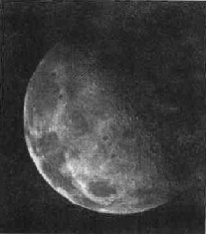
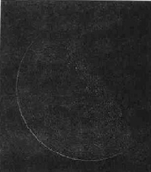
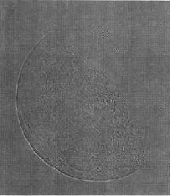
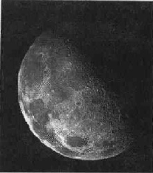
Spatial filtering
Laplacian Example
(a)Original image (b)Laplacian result ( c)Rearranged Laplacian result (d) After fusion

Slide 33
Spatial filtering
Laplacian: example
1
1
1
1
-8
1
1
1
1
(a) Original image
(b) Laplacian result

Slide 34
Spatial filtering
Laplacian: example
Rearrange the Laplacian result in terms of enhancing level
(b) Laplacian result
(c) Rearranged Laplacian result

Slide 35
Spatial filtering
Laplacian-example
Fuse
(a) Original image
(d) After fusion

Slide 36
Bilateral filtering
Gaussian smoothing
Bilateral filtering
Input

Slide 37
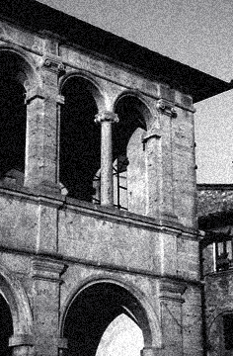

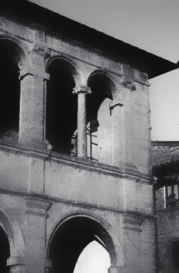
Input (Noisy image)
Gaussian filtering
Bilateral filtering

Slide 38
The bilateral filter is becoming a basic tool in computational photography.
Many applications with high quality results.
Not always the best result but often good
Easy to understand, adapt and setup

Slide 39
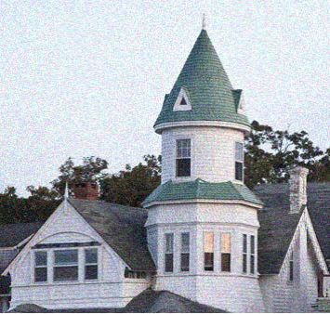
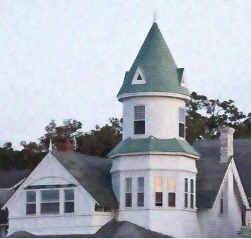
Denoise
Noisy image
Median filter

Slide 40
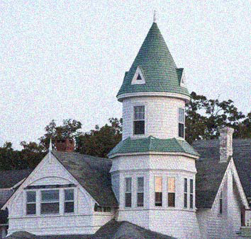
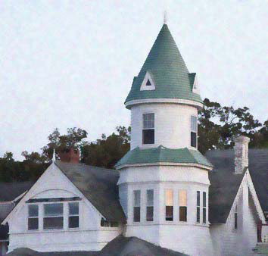
Noisy image
Bilateral filtering

Slide 41
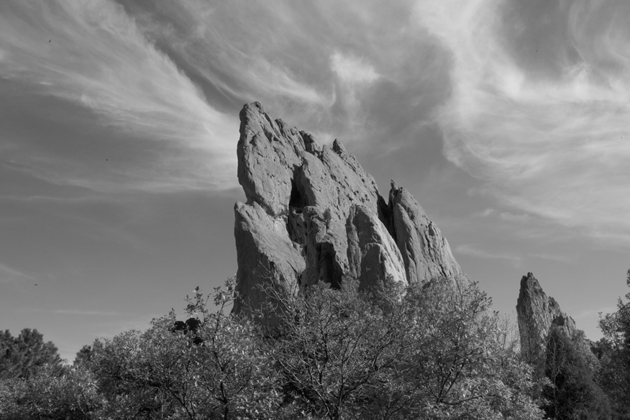
Photographic Style Transfer [Bae 06]
input

Slide 42
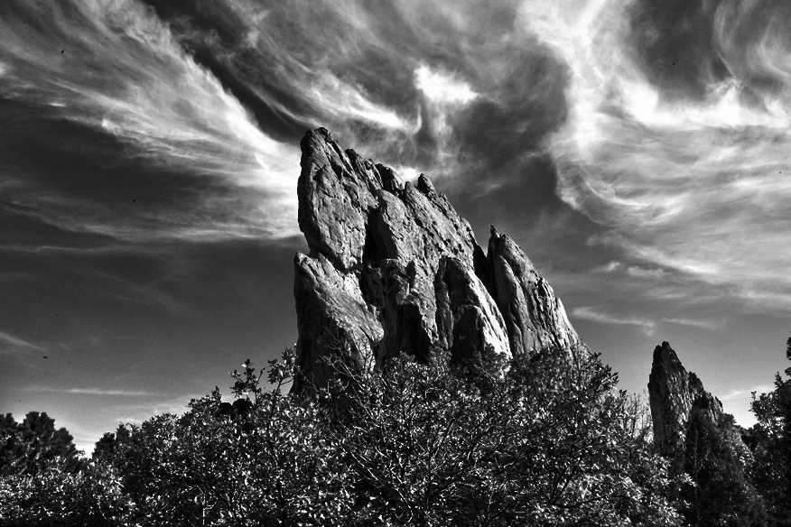
Photographic Style Transfer [Bae 06]
output

Slide 43
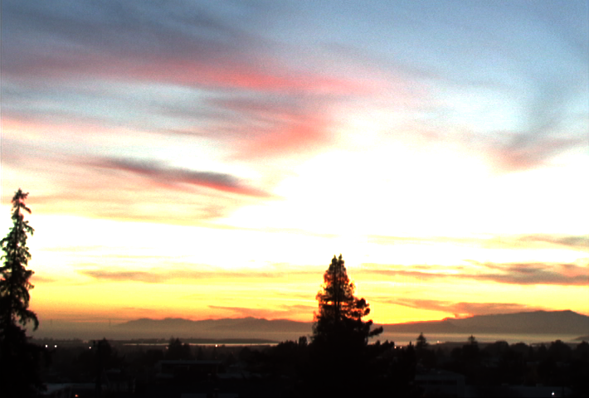
Tone Mapping [Durand 02]
HDR input

Slide 44
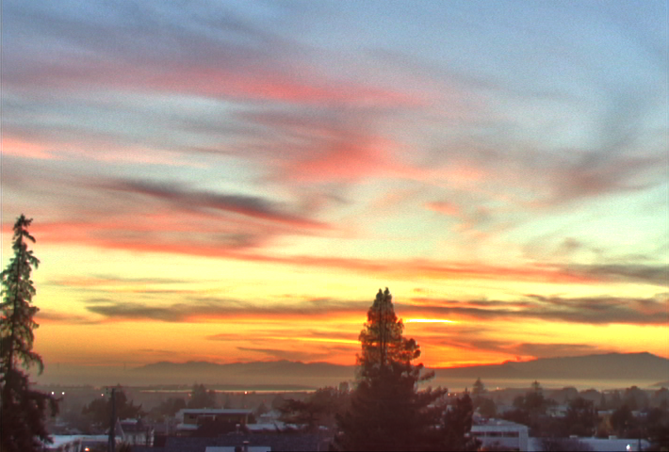
Tone Mapping [Durand 02]
output

Slide 45
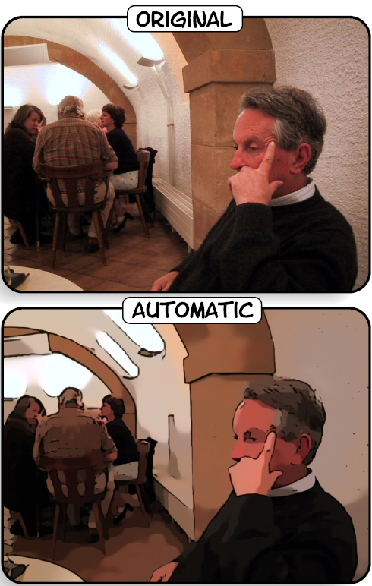
Cartoon Rendition [Winnemöller 06]
input

Slide 46
Cartoon Rendition [Winnemöller 06]
6 papers at SIGGRAPH’07
output

Slide 47
Goal: Image Smoothing
Split an image into:
large-scale features, structure
small-scale features, texture

Slide 48


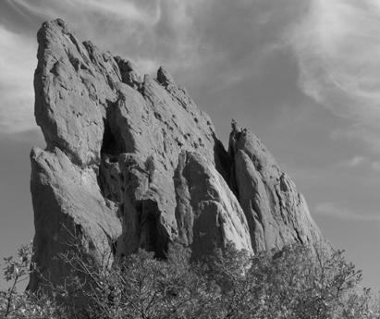
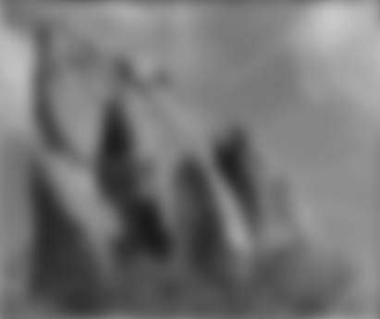

Gaussian Blur
per-pixel multiplication
*
input
output
average

Slide 49
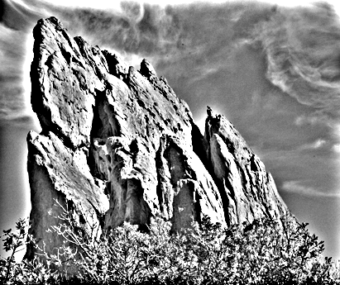
Gaussian filtering
BLUR
HALOS
smoothed (structure, large scale)
residual (texture, small scale)
input
Gaussian Convolution

Slide 50
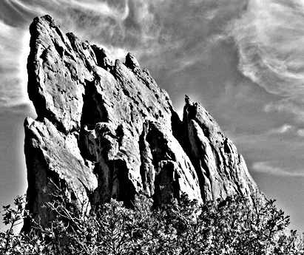
Impact of Blur and Halos
If the decomposition introduces blur and halos, the final result is corrupted.
Sample manipulation: increasing texture (residual × 3)

Slide 51
input

Slide 52
increasing texture with Gaussian convolution H A L O S

Slide 53
Bilateral filter: General Idea
An image has two main characteristics
The space domain S, which is the set of possible positions in an image. This is related to the resolution, i.e., the number of rows and columns in the image.
The intensity domain R, which is the set of possible pixel values. The number of bits used to represent the pixel value may vary. Common pixel representations are unsigned bytes (0 to 255) and floating point.

Slide 54
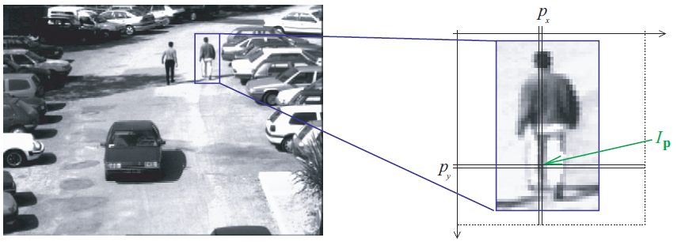

Slide 55
Bilateral filter: General Idea
Every sample is replaced by a weighted average of its neighbors,
These weights reflect two forces
How close are the neighbor and the center sample, so that larger weight to closer samples,
How similar are the neighbor and the center sample – larger weight to similar samples.
All the weights should be normalized to preserve the local mean.

Slide 56

Revisit Gaussian Blur
Weighted average of pixels.
normalized Gaussian function
1
0

Slide 57


Gaussian Profile
Pixel weight
pixel position
unrelated
pixels
uncertain
pixels
related
pixels
uncertain
pixels
unrelated
pixels

Slide 58


Spatial Parameter
input
size of the window
small σ
large σ
limited smoothing
strong smoothing

Slide 59
How to set σ
Depends on the application.
Common strategy: proportional to image size
e.g. 2% of the image diagonal
property: independent of image resolution

Slide 60
Properties of Gaussian Blur
input
Does smooth images
But smoothes too much: edges are blurred.
Only spatial distance matters
No edge term
output
space

Slide 61



Blur Comes from Averaging across Edges
*
input
output
*
*
Same Gaussian kernel everywhere.

Slide 62

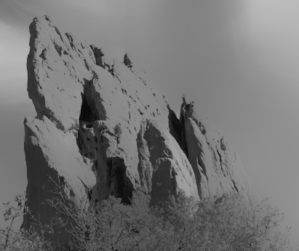


Bilateral Filter No Averaging across Edges
*
input
output
*
*
The kernel shape depends on the image content.

Slide 63

Bilateral Filter Definition: an Additional Edge Term
Same idea: weighted average of pixels.
new
not new
new
normalization factor
space weight
Intensity weight
I

Slide 64
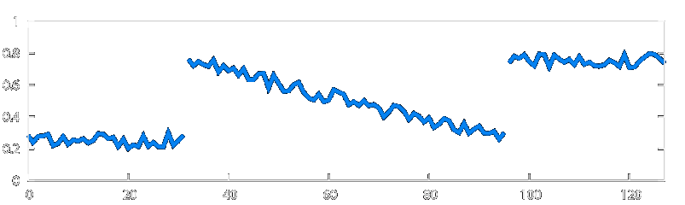
Illustration a 1D Image
1D image = line of pixels
Better visualized as a plot
pixel intensity
pixel position

Slide 65
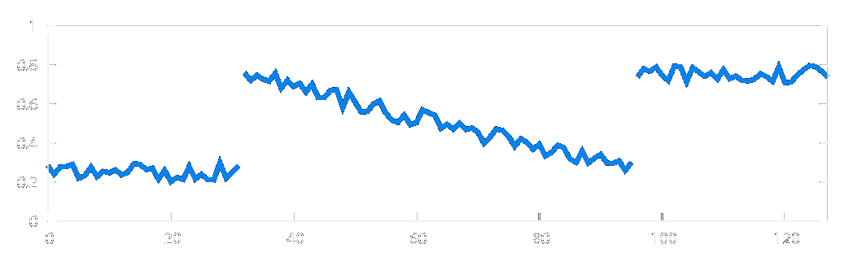


Gaussian Blur and Bilateral Filter
Gaussian blur
p
q
space
space
Bilateral filter [Aurich 95, Smith 97, Tomasi 98]
p
Intensity
q
space
Intensity
normalization
space

Slide 66

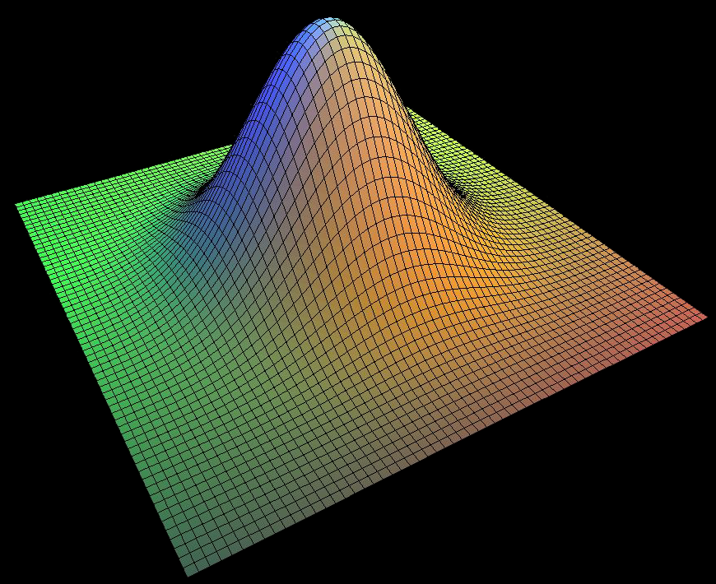
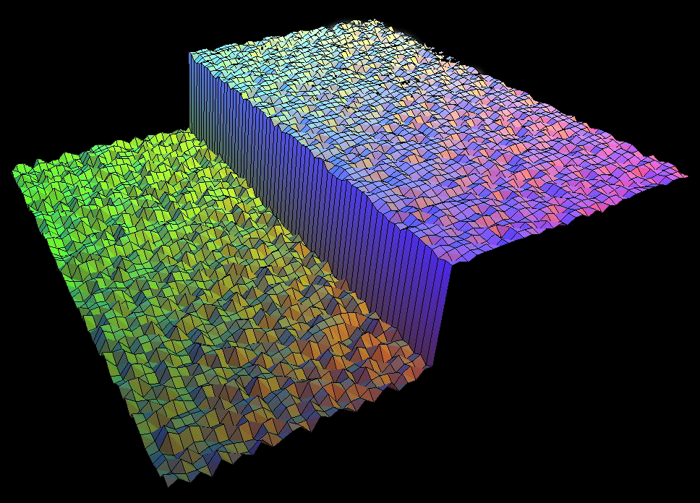
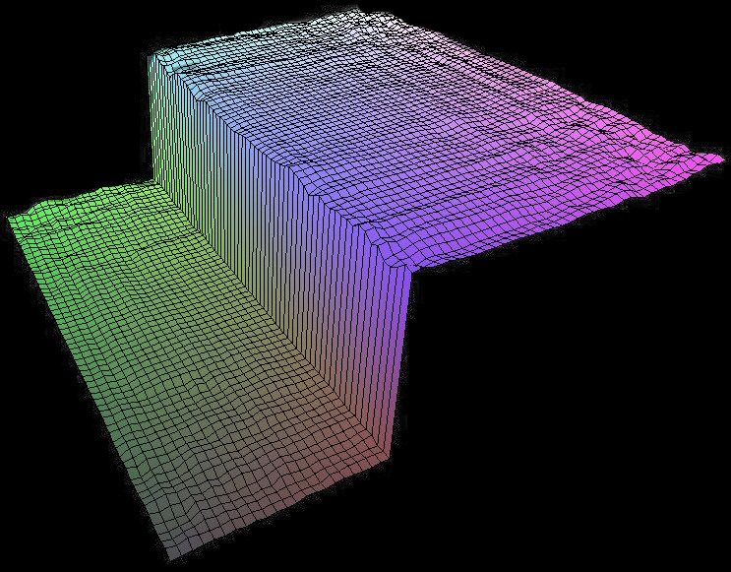
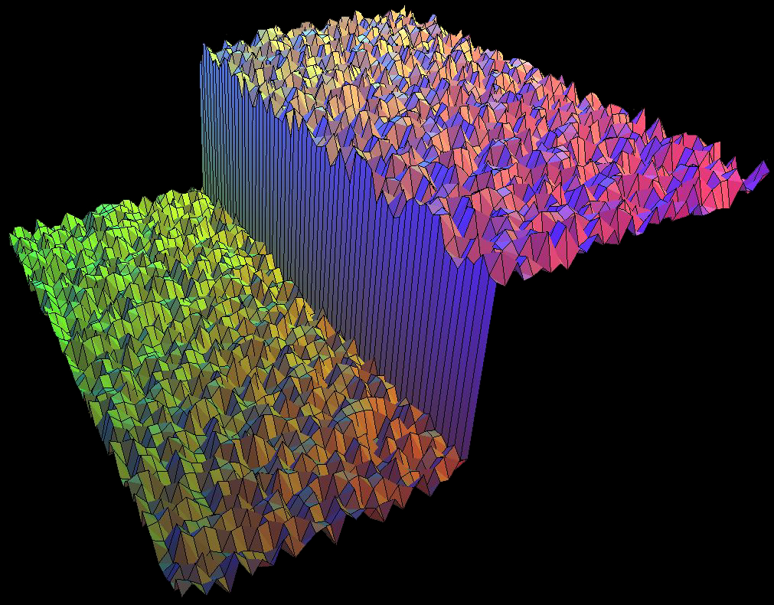
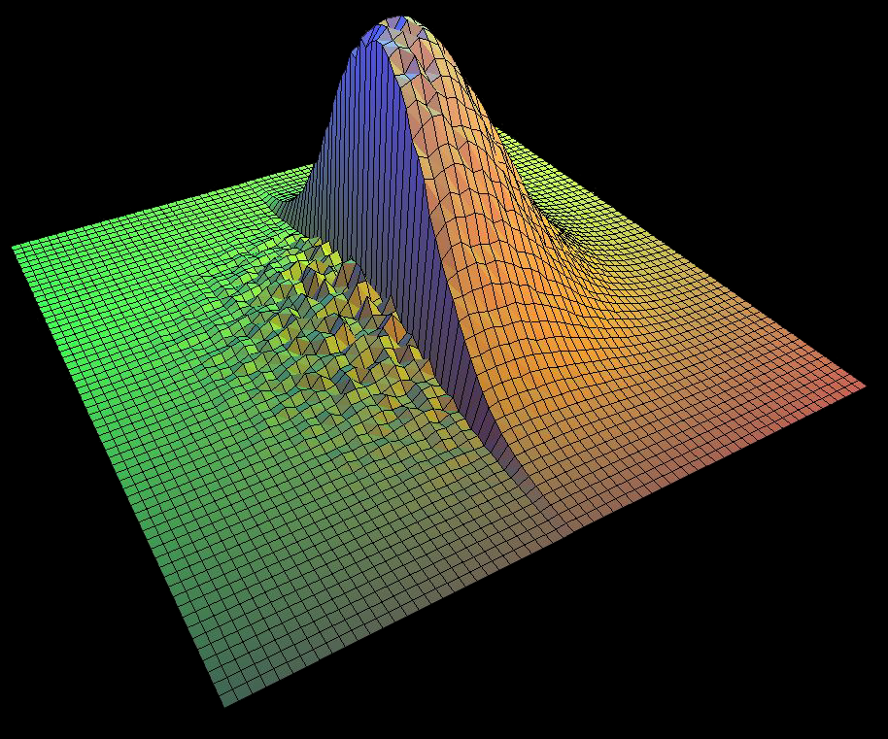
Bilateral Filter on a Height Field
output
input
reproduced from [Durand 02]

Slide 67
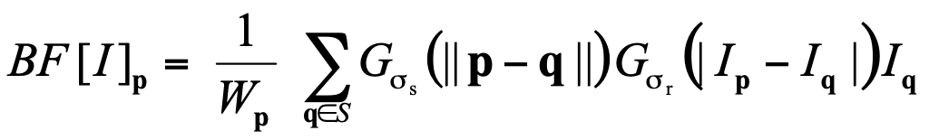
Space and Intensity Parameters
space σ_{s} : spatial extent of the kernel, size of the considered neighborhood.
intensity σ_{r} : amplitude extent of an edge

Slide 68
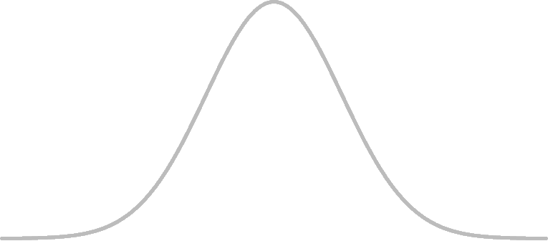
Influence of Pixels
Only pixels close in space and in intensity are considered.
space
intensity
p

Slide 69

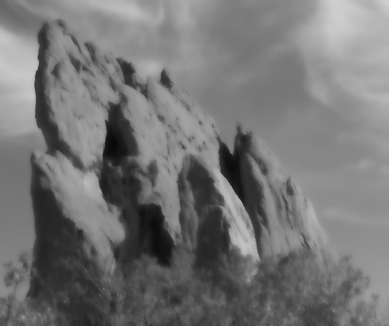




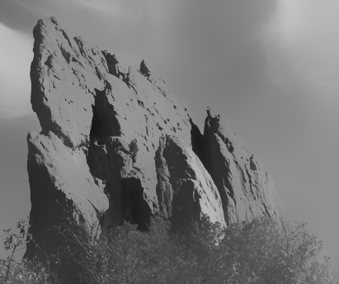
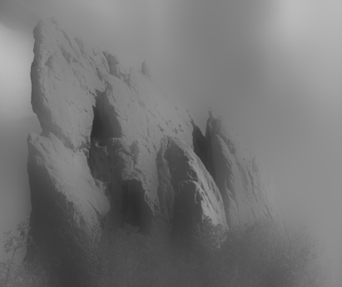

Exploring the Parameter Space
s_{r} = ¥ (Gaussian blur)
s_{r} = 0.1
s_{r} = 0.25
input
s_{s} = 2
s_{s} = 6
s_{s} = 18

Slide 70
Varying the Intensity Parameter
s_{r} = ¥ (Gaussian blur)
s_{r} = 0.1
s_{r} = 0.25
input
s_{s} = 2
s_{s} = 6
s_{s} = 18

Slide 71
input

Slide 72
s_{r} = 0.1

Slide 73
s_{r} = 0.25

Slide 74
s_{r} = ¥ (Gaussian blur)

Slide 75
Varying the Space Parameter
s_{r} = ¥ (Gaussian blur)
s_{r} = 0.1
s_{r} = 0.25
input
s_{s} = 2
s_{s} = 6
s_{s} = 18

Slide 76
input

Slide 77
s_{s} = 2

Slide 78
s_{s} = 6

Slide 79
s_{s} = 18

Slide 80
How to Set the Parameters
Depends on the application. For instance:
space parameter: proportional to image size
e.g., 2% of image diagonal
intensity parameter: proportional to edge amplitude
e.g., mean or median of image gradients
independent of resolution and exposure

Slide 81

Iterating the Bilateral Filter
Generate more piecewise-flat images
Often not needed in computational photo.

Slide 82
input

Slide 83

1 iteration

Slide 84

2 iterations

Slide 85

4 iterations

Slide 86


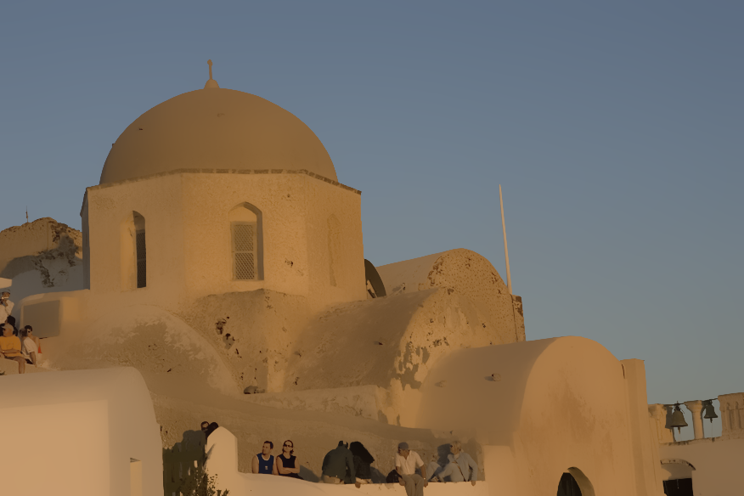

Bilateral Filtering Color Images
input
For gray-level images
intensity difference
scalar
output
For color images
color difference
3D vector (RGB, Lab)
The bilateral filter is extremely easy to adapt to your need.

Slide 87
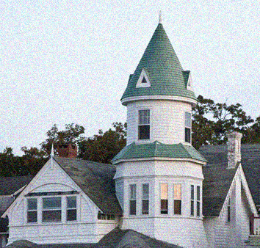

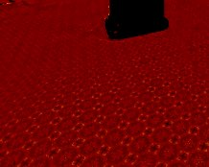
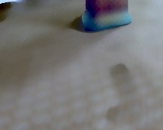
Overview
Denoising
Tone mapping
Relighting & texture editing

Slide 88
Overview
Denoising
Tone mapping
Relighting & texture editing
Not most powerful application Not best denoising, but good & simple

Slide 89
Basic denoising
Noisy input
Bilateral filter 7x7 window

Slide 90
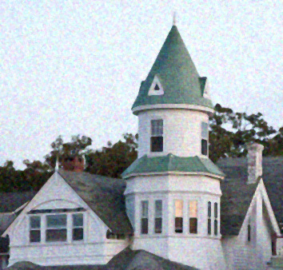
Basic denoising
Bilateral filter
Median 3x3

Slide 91
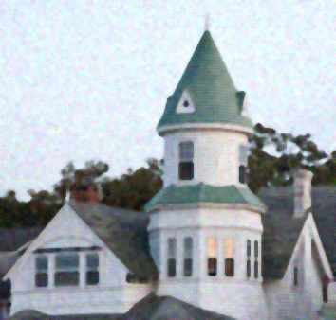
Basic denoising
Bilateral filter
Median 5x5

Slide 92

Basic denoising
Bilateral filter
Bilateral filter – lower sigma

Slide 93

Basic denoising
Bilateral filter
Bilateral filter – higher sigma

Slide 94

Denoising
Small spatial sigma (e.g. 7x7 window)
Adapt intensity sigma to noise level
Maybe not best denoising method, but best simplicity/quality tradeoff
No need for acceleration (small kernel)
But the denoising feature in e.g. Photoshop is better

Slide 95
Overview
Denoising
Tone mapping
Relighting & texture editing

Slide 96
Real world dynamic range
Eye can adapt from ~ 10⁻⁶ to 10⁶ cd/m²
Often 1 : 10,000 in a scene
10⁻⁶
10⁶
Real world
High dynamic range

Slide 97
Problem: Contrast reduction
Match limited contrast of the medium
Preserve details
10⁻⁶
High dynamic range
10⁶
Real world
10⁻⁶
10⁶
Picture
Low contrast

Slide 98
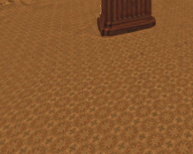
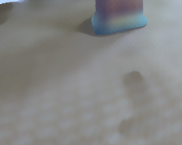
Overview
Denoising
Tone mapping
Relighting & texture editing

Slide 99
Overview
Denoising
Tone mapping
Relighting & texture editing
Not most powerful application Not best denoising, but good & simple

Slide 100
Basic denoising
Noisy input
Bilateral filter 7x7 window

Slide 101
Basic denoising
Bilateral filter
Median 3x3

Slide 102
Basic denoising
Bilateral filter
Median 5x5

Slide 103
Basic denoising
Bilateral filter
Bilateral filter – lower sigma

Slide 104
Basic denoising
Bilateral filter
Bilateral filter – higher sigma

Slide 105
Denoising
Small spatial sigma (e.g. 7x7 window)
Adapt range sigma to noise level
Maybe not best denoising method, but best simplicity/quality tradeoff
No need for acceleration (small kernel)
But the denoising feature in e.g. Photoshop is better

Slide 106
Overview
Denoising
Tone mapping
Relighting & texture editing

Slide 107
Real world dynamic range
Eye can adapt from ~ 10⁻⁶ to 10⁶ cd/m²
Often 1 : 10,000 in a scene
10⁻⁶
10⁶
Real world
High dynamic range

Slide 108
Problem: Contrast reduction
Match limited contrast of the medium
Preserve details
10⁻⁶
High dynamic range
10⁶
Real world
10⁻⁶
10⁶
Picture
Low contrast

Slide 109
Tone mapping
Input: high-dynamic-range image
(floatting point per pixel)

Slide 110
Naïve technique
Scene has 1:10,000 contrast, display has 1:100
Simplest contrast reduction?

Slide 111

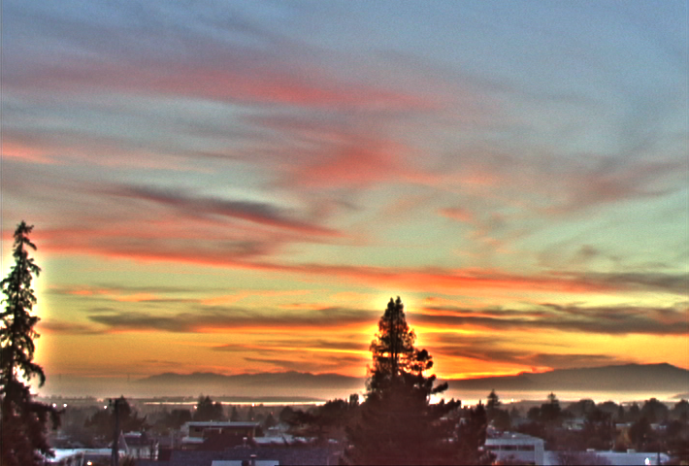
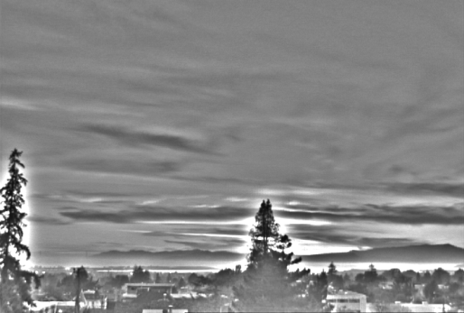

The halo nightmare
For strong edges
Because they contain high frequency
Low-freq.
Reduce low frequency
High-freq.
Color

Slide 112
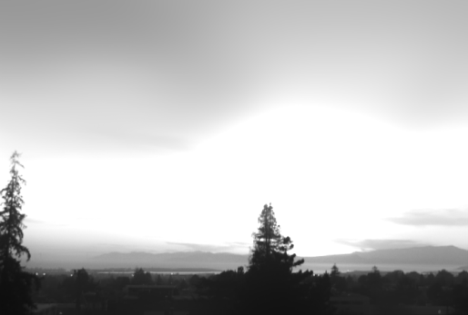
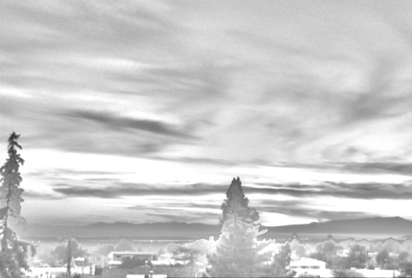

Bilateral filtering to the rescue
Large scale = bilateral (log intensity)
Detail = residual
[Durand & Dorsey 2002]
Large-scale
Output
Detail
Color

Slide 113

Hard to Compute
Nonlinear
Complex, spatially varying kernels
Cannot be pre-computed
Brute-force implementation is slow > 10min

Slide 114
Brute-force Implementation
For each pixel p
For each pixel q
Compute
8 megapixel photo: 64,000,000,000,000 iterations!
V E R Y S L O W !
More than 10 minutes per image

Slide 115
Bilateral filtering
Gaussian smoothing
Bilateral filtering
Input

